Slide 1
A Healthy Diet for our children – what does this mean?
Collette Green
Specialist Paediatric Dietitian
ESNEFT

Slide 2
Outline
Healthy eating guidelines
Packed lunches & school meals
Food allergies
Obesity
Food & behaviour
Eating disorders

Slide 3
Introduction
A healthy diet is crucial to give the right balance of foods to meet nutritional needs and support the brain, children require:
Energy for growth – children still actively growing
Protein to build new tissues – repair & growth
Vitamins and mineral for healthy growth and development - Including brain
Fibre for bowel health
We encourage variety to ensure a wide range of nutrients to stay healthy
Regular meals – helps regulate blood sugar
Common childhood nutritional problems include constipation, iron deficiency anaemia, food refusal/fussy eating, overweight/obesity, food allergies and Vitamin D deficiency.

Slide 4
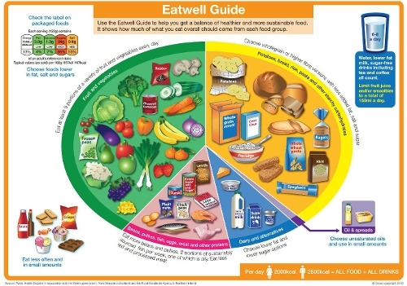
What does an adequate and varied diet look like?
Notes:
For most children over two years of age (and adults), if they are including a variety of foods from each of the food groups of the on a daily basis, they are likely to be getting most of what they need.

Slide 5
Healthy eating guidelines
School age children grow fast and still have high nutritional requirements in relation to their body size
Adult needs 35 kcals / kg
10 year old needs 68 kcals / kg
5 year old needs 90 kcals / kg
Children also require adequate iron, protein, vitamin A, C & D, fibre and calcium as the key nutrients
Appetites vary from day to day. Eat better if in a routine.
What, and how, children eat can affect their mood, behaviour and learning.
Notes:
From around 5 years of age healthy eating should be encouraged but start to establish healthy eating habits from as early as possible.
Vit D mainly synthesised in body from sun
Vit A required for eye development, skin, immune system and normal growth
Vit C needed for enhanced iron absorption and wound healing and a deficiency leads to scurvy.
Iron needed for making red blood cells
Inadequate protein affects growth and muscle development
Fibre helps you feel full for longer and is essential for gut function – a lack can cause constipation

Slide 6
Carbohydrate foods
These are required to provide the body with energy
Complex carbohydrates best, simple carbohydrates (sugars)- limit
Each meal should be based on food from this group
Higher fibre varieties help children feel full for longer (advised from 5 years of age)
Children should be discouraged from following a low carb diet as children require these foods for growth.

Slide 7
Protein & Omega 3
Consists of meat, fish, eggs, beans and other non dairy sources.
As well as protein provides essential minerals including iron.
School meals should include a portion of this each day.
Can be a good source of Omega – 3 (essential fatty acid) – support proper development & functioning of the brain
Main sources of omega 3’s – flaxseed oil, walnuts, cod liver oils, offal, seafood and oily fish
Some reports that children with ADHD and associated behavioural problems have low blood omega 3 levels – no current evidence of a strong link

Slide 8
Fruit and Vegetables
Should aim for 5 portions per day
Rough portion guide – size of palm of child’s hand
Can be fresh, frozen, tinned, dried or juice (although avoid excessive fruit juice and combine with a meal).
School fruit snacks can contribute to reaching target
Provide a variety of essential vitamins and minerals
Important to prevent deficiencies such as scurvy, anaemia

Slide 9
Fibre
It is well known that fibre is important for gut health. It also seems to help regulate blood sugar, which may help with mood and attention.
The positive effects on mood and attention of eating a meal, may last for a shorter time if there is less fibre.
Dietary fibre and some fermented foods (like live yoghurt) may also promote a healthy “microbiome” (the name given to the billions of micro-organisms living in our gut). This may, in turn, also contribute to good mood and general wellbeing, in ways that are not yet fully understood.

Slide 10
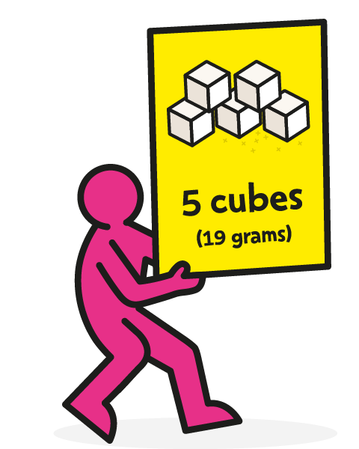
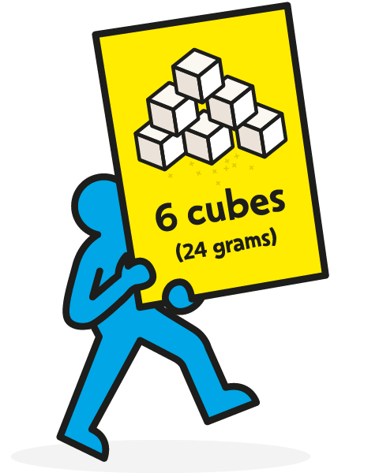
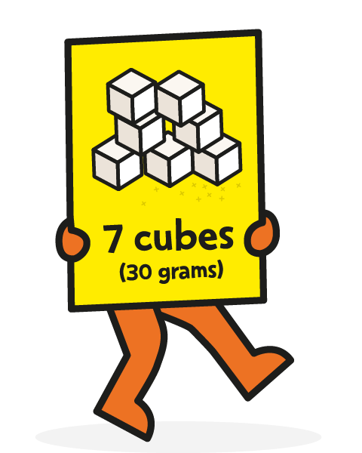
Foods and drinks high in fat and sugar
A healthy diet should be low in these foods
These foods provide extra energy and few nutrients.
Children are eating too much sugar (>2x what they should)
Can cause a build up of bad fats and lead to weight gain as well as tooth decay/type 2 diabetes
How much is too much?
Notes:
5 cubes 4-6 yrs, 6 cubes 7-10 yrs, 7 cubes 11+

Slide 12
Fluid
Adequate hydration is vital for good health.
Dehydration can cause a lack of concentration, tiredness and dizziness.
Drinking water is the easiest way to get sufficient fluid
Children need frequent reminders as don’t recognise thirst as well
Recommended intakes:
4-8yrs 1280ml
9-13yrs Boys 1680mls & Girls 1520mls
>14yrs adult recommendation
Notes:
Some evidence children who drink extra water perform better in attention and memory tests.

Slide 13
Packed lunches & School meals
Often schools have a healthy eating policy which encompasses packed lunches
Should be encouraged to adhere to healthy eating guidelines
More likely to provide excess fat and sugar
Packed lunches can be important for some children especially restricted diets
School meals have standards set by the government which schools have to meet.
Free school meals and snacks can help support healthy eating

Slide 14
Food allergies/Intolerances
Some children have food allergies/intolerance(s) which can mean that their mood or behaviour are affected by specific foods or ingredients. These can produce physical symptoms too.
Can cause issues such as eczema, anaphylaxis, nausea and vomiting, abdominal pain and growth issues.
Milk, soya, egg and peanut allergies most common
5-8% of children suffer with food allergies
Under section 100 of The children and families act (2014) schools have a duty to support pupils with medical conditions
Food information Regulations 2014 requires all schools to list allergens
Children with food allergies can have much more limited diets

Slide 15
Obesity
Since 1992 rates of children who are overweight/obese have doubled.
School meals should aim to be healthy to improve children's health – especially obesity
Last data showed 22% reception children and 34% Year 6 were overweight/obese
Associated with psychological and emotional issues – including bullying.
Children who are overweight/obese more likely to be in adulthood

Slide 16
Food & behaviour
Eating a wide variety of nutritious foods helps mood, attention and learning.
Eating regular meals also helps promote good mood and attention.
Including foods that are rich in dietary fibre may also help.
Nutritional supplements may help some children. This is especially true when the diet is low in any particular nutrients.
Some evidence children with ADHD can benefit from supplements
No evidence of benefit of milk & gluten free diets in ASD

Slide 17
Eating Disorders
Eating disorder is a mental health condition where food/excessive exercise is used to cope with feelings/emotions
Can affect at any age but usually teenagers (13-17) most affected
Includes anorexia nervosa, bulimia, binge eating disorder.
Physical signs include poor tolerance to cold, dramatic weight loss, periods stopping. Changes in mood, obsessing around food and or exercise
Rising percentage in young males, younger children (including primary school age) and levels overall post covid.
ARFID (Avoidant Restrictive Food Intake Disorder) – very limited diet & can be due to fear of eating, lack of interest in food and sensory issues. Strongly associated with ASD

Slide 18
Conclusion
A healthy diet is important for normal growth and development
It is also required to reduce the risk of being overweight/obese
Children need a healthy diet combined with exercise to maintain a healthy weight
A good variety reduces risk of lack of specific nutrients
A regular and well balanced diet can be helpful to ensure good energy levels, better concentration and adequate development

Slide 19
Thank you

