Slide 1
Hypermobility
Nicky Race
Senior paediatric Physiotherapist

Slide 2
Objectives
What is hypermobility
Signs and symptoms
Management of hypermobility
Role of the Physiotherapist
How to support a child/ family with hypermobility
Case studies
Questions and answers

Slide 3
What is hypermobility?
Hypermobility is a description of joint movement. The ligaments that offer stability to a joint are lax and therefore the joints have more flexibility
Hypermobility lies within a spectrum, it is a common condition within the general population and many individuals do not experience any significant difficulties
Hypermobility should be regarded as a “normal variant”, difficulties manly occur when there is imbalance of muscle or when there is deconditioning.
Hypermobility affects between 8-39% of school age children, with girls more commonly affected than boys (Castori and Hakim 2017)
Hypermobility can occur throughout the body and is assessed using the Beighton scale.

Slide 4
Ehlers-Danlos syndrome
The Ehlers-Danlos syndromes (EDS) are heritable connective tissue disorders affecting the quality of collagen in every part of the body. loose, unstable joints that dislocate easily. Symptoms include:
joint pain and clicking joints.
extreme tiredness (fatigue)
skin that bruises easily.
digestive problems, such as heartburn and constipation.
dizziness and an increased heart rate after standing up.
In 2017 a new international classification of Ehlers-Danlos syndrome (EDS), joint hypermobility and related disorders was published.
Strict criteria must be achieved in order to be given the diagnosis of Hypermobile EDS (hEDS)
13 different subtypes of EDS, with genetic testing. No genetic test for hEDS, hence the strict criteria (Ehlers-danlos society.com 2021)

Slide 5
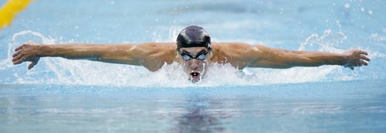
Marfans Syndrome
Hereditary connective tissue disorder. Gene defect causes abnormal production of fibrillin resulting in parts of the body being able to stretch abnormally when placed under any kind of stress.
Classic symptoms included being tall, longer arm span to height, stretchy skin that scars easily, hypermobile, facial features that include deep set eyes, over crowded teeth, high palate, pectus excavatum or pectus carinatum and scoliosis
If suspected patient will be sent for genetic testing and assessment of the heart and eyes. (NHS 2019)

Slide 6
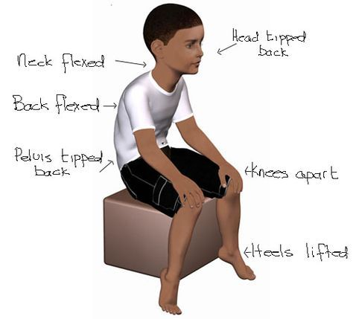
Common symptoms
Clicky joints
Pain
Fatigue
Difficulty sitting still or low toned posture
Flat feet
Reduced balance and coordination
Reluctance to walk any distance or participate in physical activity
Struggles with fine motor skills such as handwriting and shoe laces

Slide 7
Physiotherapy management
Empower the CYP and families to understand the management and develop confidence, skills and knowledge in self management strategies
Reassure ++++
Encourage/pace normal activities, PE and sports specific activities
Exercise programmes to target imbalances
Postural advice
Core and balance strengthening such as Pilates
Liaison with multidiscipline team, guardians and schools
(APCP 2021)

Slide 8
PE and support
Though it is usually okay for a child to participate in all PE it is important to know if they have the strength and stamina before engaging in a given activity.
Contact sports may need more prep than others
Children with hypermobility may struggle during PE and may have a dislike to physical exercises. They may find it difficult to keep up with peers and could lack skills, such as coordination, which makes team contact sports even more challenging
There could be a lack of confidence in performing PE, even dread at not keeping up or dropping the ball.
It is important to have a good variety on offer, options to have a rest and encouragement to return once rested.
Pilates, gym balls, coordination, gym trail.
Activities the child enjoys doing!!!

Slide 9
Case study 1
5 year old boy with history of falls and difficulty with fine motor skills reported by school.
Often wakes at night with pain in his legs, worse on a busy day
Family history of Hypermobility
Mum’s main concern is feet roll in/flat feet. Sometimes walks on their toes
On examination found to have flexible feet and global hypermobility. No structural issues or red flags
Treatment: Reassured ++, normalised hypermobility and flat feet, advice given around footwear, increasing physical activity with swimming, play parks and centres. Issued with balance exercises and core work. School liaison and OT as required. Open appointment for parental reassurance.

Slide 10
Case study 2
13 yr old girl, with recurrent history of clicking hips and subluxing knees. Sometimes gets swelling. Poor posture. Dislikes PE but use to swim ++
Family history of hypermobility. Mum has had lot’s of issues with her feet and back and doesn’t want her daughter to suffer like she has.
On examination, tall and slim with long, thin foot. Low toned posture. Beighton score of 9/9. No swelling or structural issues
Reassured ++, explained management of hypermobility. Encourage increase of normal activity. Suggest going back to swimming, Pilates, cycle. School liaison. Footwear advice, consider insoles if symptoms not improving. Follow up 8/52 and progress as able. Aim to see max of three times before self management.

Slide 11
References and resources
APCP www.apcp.csp.org.uk Symptomatic hypermobility leaflet
Castori, M. and Hakim, A (2017) Contemporary approach to joint hypermobility and related disorders. Current opinions in paediatrics 29(6), 640-647
British Society for Rheumatology (2019) Guidance for management of symptomatic Hypermobility in children and young people- A guide for professionals managing children and young people with this condition
NHS 2019 Marfans syndrome www.nhs.co.uk/conditions/marfan-syndrome
What is hEDS(2021) www.ehlers-danlos.com

