Slide 1
Cystic Fibrosis
Dr Imogen Rose
Paediatric Consultant with special interest in CF, Respiratory medicine & Allergy
21st June 2021

Slide 2
Outline
What is CF?
How is it diagnosed?
What causes it?
How does CF affect the body?
How is it treated?
The CF team
What can schools do to help?
Resources available

Slide 3
What is CF?
Genetic
Affects 11,000 people in UK
2 people die/week from CF
5 babies born a week with CF
1 in 25 carry faulty gene
Life-limiting condition
50% of those with CF will live until ~47
Notes:
Life expectancy improving all the time

Slide 4
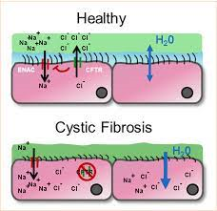
What is CF?
Faulty gene that affects the body’s ability to make or direct CFTR protein
Disrupts the movement of salt and water in and out of cells
Makes mucous thicker & stickier
Notes:
Cystic fibrosis transmembrane regulator protein

Slide 5
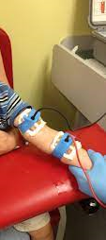
How is it diagnosed?
Carrier testing
Antenatal testing (CVS or amniocentesis)
Newborn screening
Heel prick test since 2007
Sweat test
>60 = CF

Slide 6
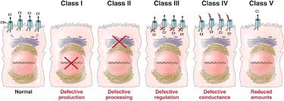
What causes it?
Can’t be caught or developed
If you are not born with CF you will never have it but could be a CF gene carrier
1 in 25 people carry CF gene
Everyone with CF will have 2 faulty or “mutated” CF genes
>2000 mutations that can cause CF
Specific mutation important as determines treatment → personalised care

Slide 7
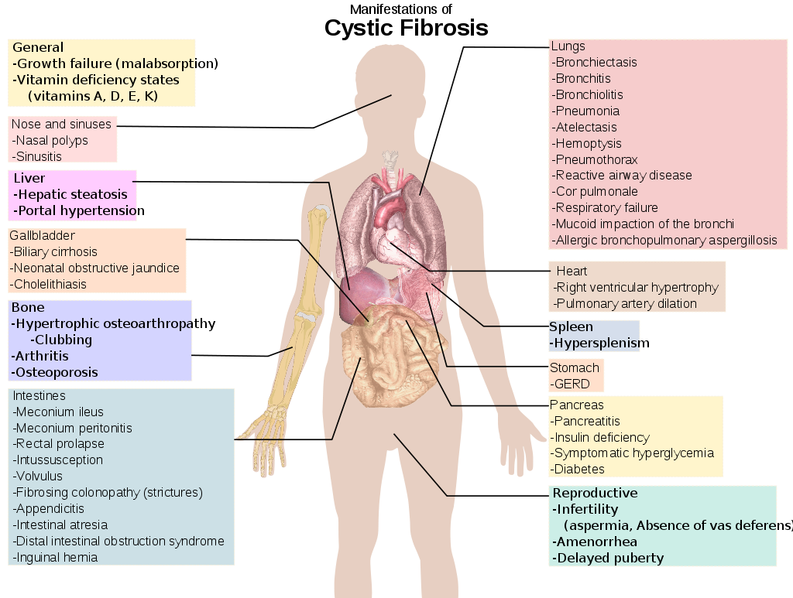
Notes:
Multisystem disease

Slide 8
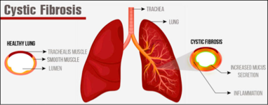
Lungs
15,000 miles of airways
Normal lungs - Thin layer of mucous containing cilia to capture bacteria but,
CF lungs - mucous is thicker & stickier so traps bacteria
Chronic cough
Wheeze
SOB
Recurrent chest infections

Slide 9
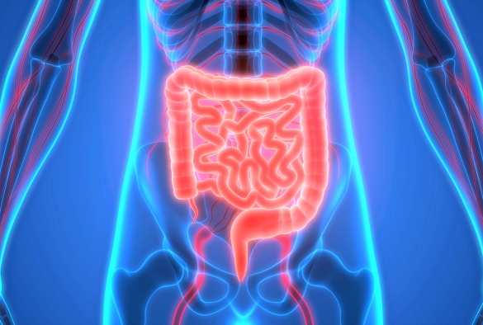
Digestive system
Loose, greasy large volume stools
Weight loss
Constipation
Nausea
Swollen abdomen
Reduced appetite
DIOS – blockages in small bowel
GORD – acid & non acid contents of stomach move in wrong direction
Notes:
Difficulties digesting fat due to lack of enzymes
1 in 10 babies born with CF get meconium ileus – bowel obstruction – needs urgent operation
GORD – provokes coughing,

Slide 10
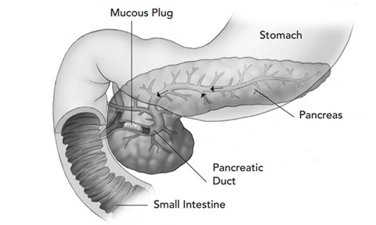
Pancreas
Pancreas makes digestive enzymes that break down fats/protein & carbs
Small tubes blocked with mucous
Enzymes can’t get out → inflammation of pancreas
Artificial enzymes (Creon)
Scarring causes reduces production of insulin → CFRD (CF related diabetes)
Notes:
Pancreatic enzymes important to allow nutrients that body uses for energy
1/3 of patients will have CFRD

Slide 11
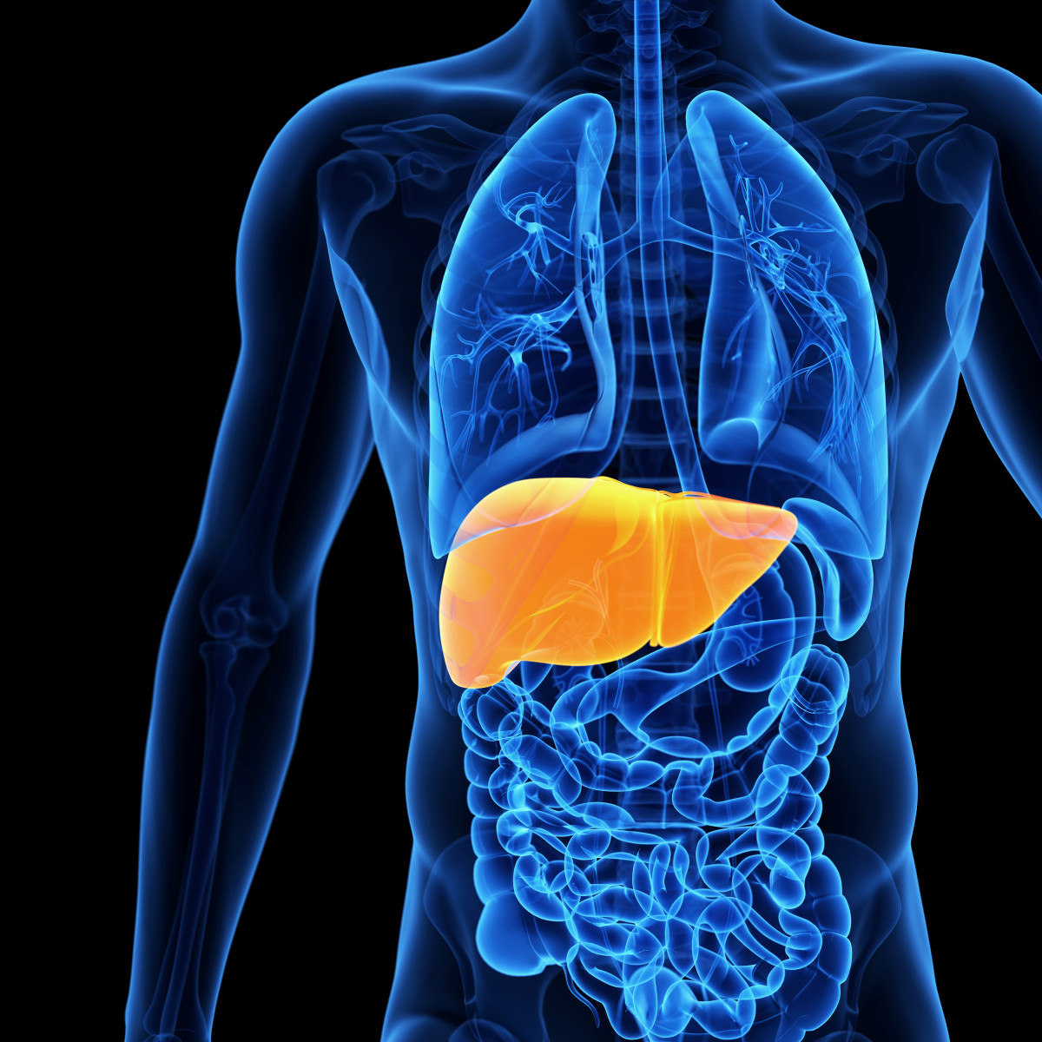
Liver
Sits under R ribcage
Largest solid organ in body
Creates bile that digests fat in food
Produces protein & hormones/ filters toxins
5-10% of CF patients will have liver disease
Thicker bile, doesn’t flow easily, causes irritation/scarring → fibrosis

Slide 12
Bones
Notes:
Osteopenia & osteoporosis – skeleton has low bone mass so more fragile
DEXA scan screening from age 12
5-10% will get arthritis

Slide 13
Fertility problems
Women:
Many have babies without fertility treatment but:
Irregular/absent periods due to illness/underweight
Thicker vaginal mucous which can make it harder for sperm to reach egg
Men:
98% will have infertility - tube that carries sperm from testicles to penis (vas deferens) is either missing or blocked
We discuss fertility in teenage years but still important to explain about STIs!
Notes:
A woman can become too poorly to safely be pregnant – poor lung function, respiratory failure, heart or severe liver disease, certain infections

Slide 14
Additional symptoms
Salty skin – need to increase salt intake in hot weather/exercise
Kidney & hearing complications – medication s.e
Sinusitis
Nasal polyps
Clubbed fingers
Psychological impact is huge

Slide 15
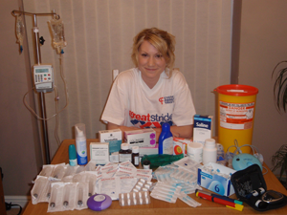
How is CF treated?
No cure…….(yet)
Antibiotics
Physio (at least twice daily)
Nebulisers
Inhalers
Enzyme capsules (every meal/snack)
High fat diet
Mucolytics (to thin mucous)
(insulin/liver drugs)
>40 tablets/day on average
Lung transplant
Oxygen
CFTR modulators
Notes:
CFTR modulators – funding approved 2019
Only for certain mutations
£90,000/pt/yr

Slide 16
The CF team
Ipswich:
Doctor – me!
Specialist nurse – Karen Richards
Physio – Penny Brown, Ali Angell
Dietician – Lindsey Mowles
Psychologist – Dr Mel Powell
Addenbrookes team (annual review & support of local team)

Slide 17
What can schools do to help?
LOTS!
Huge burden of care – physio, meds, nebulisers etc takes a long time before & after school so understand if children late, tired or find it difficult to concentrate
Persistent cough - is the body shifting the mucous out of the lungs. NOT INFECTIOUS. Can be embarrassing to cough but it helps keep lungs clear
Enzyme supplements – Creon – too much or too little = abdo pain, urgent need to use the toilet
Usual healthy eating guidelines don’t completely apply as we need them to have high fat diet

Slide 18
What can schools do to help?
Cant’ mix with other CF children
Environmental bugs that can cause very difficult infections live in damp/rotting vegetation or stagnant water so may need some school trips/outdoor activities adapted
MOST OF THE TIME THEY CAN STILL GO!
Often health deteriorates over time not rapidly so safe for school trips with careful planning
If CF well managed encourage them to work hard in PE & motivate them to get into optimal aerobic zones
OK FOR THEM TO BE OUT OF BREATH!
Be aware of ports

Slide 19
What can schools do to help?
Sit them away from someone with heavy cold symptoms
Seen in clinic for half day every 3 months and whole day once a year
Hospital admissions – antibiotics always 2-3 weeks so may be combo of hospital & home
Stay in touch about homework
Some children happy to talk about CF, others really private - talk to them about this, make sure everyone on the same page about sharing information with others

Slide 20
Summary:
CF is a serious condition that an army of people are serious about beating for good
There is hope!
We need your support!

Slide 21
Resources
CF trust – www.cysticfibrosis.org.uk
Section for teachers
“Five feet apart” film released in 2019
Your local CF team!
CF trust YouTube channel

Slide 22
References
www.cysticfibrosis.org.uk
www.cff.org
ERS Handbook – Paediatric Respiratory Medicine; E Eber, F Midulla; 1st edition; 2013
Paediatric Respiratory Medicine; J Hull, J Forton, A Thomson; 2nd edition; 2015
Concise Paediatrics; R Sidwell, M Thomson; 2nd edition; 2009

Slide 23
Thank you!

