Slide 1
Suffolk School Nursing Service

Slide 2
Suffolk School Nursing Service
School Nurses are qualified nurses or midwives with specialist community public health training and can offer children, young people and families with children aged 5 to 19 years, including:
Support for the health and well-being
Support, advice and information on difficulties such as anxiety, stress and depression
National Child Measurement Programme (NCMP) in Reception and Year 6
Hearing and Vision screening in Reception
Access to a range of parental workshops in schools
ChatHealth, our school nursing texting service

Slide 3
We provide a range of services to help children & young people stay safe, happy and healthy.
We work alongside other agencies such as:
Health visitors
GPs
Schools
Voluntary and community groups
Other children's services, such as social care

Slide 4
SCHOOL NURSING MODEL STRUCTURE OVERVIEW The Suffolk School Nursing Model is based on the four domains and is delivered using an integrated approach.
Community Offer
A range of services (including GP, education, and community health services) for children, young people, and their families, that support children to reach their potential. SCC’s SN teams will work in partnership with other service providers to identify and meet the health needs of the local community.
Universal Offer
Supports a healthy start for every child. This includes promoting good health through education and health assessments and protecting health. All children and young people (CYP) are offered our universal service.
Universal Plus Offer
Provides a response from the SN service when there is a specific need for expert help which may be identified in a health assessment or through the provision of accessible services. This includes support for those with additional physical health needs, or sexual or emotional health and wellbeing concerns.
Universal Partnership Plus Offer
Involves the SN service working in partnership with a range of other local service providers, and the child or young person (and their family where appropriate) to meet more complex health needs that often persist over a period of time.

Slide 5
Our offer also includes …..
Health assessments for Year 6, 9 and 11 (from sept 2021).
Confidential health 'drop-ins’ or self referral appointments in secondary schools and pupil referral units for young people.
Education, Health and Care (EHC) plan support where we are involved.
Follow up (if required) for accident and emergency attendance and police domestic abuse referrals.
Support for parents and carers to feel confident in parenting skills and to provide the best opportunities for their child as their grow.

Slide 6
We also support schools by delivering:
Assemblies and group work.
Locality training for schools on management of asthma, epilepsy and anaphylaxis (in Lowestoft and Waveney this is provided by James Paget Hospital).
Individual training in schools where required.
Identifying health needs within a school community, working with schools to create a health and well-being action plan (This is currently being piloted in two areas with the aspiration to increase participation to all schools).

Slide 7
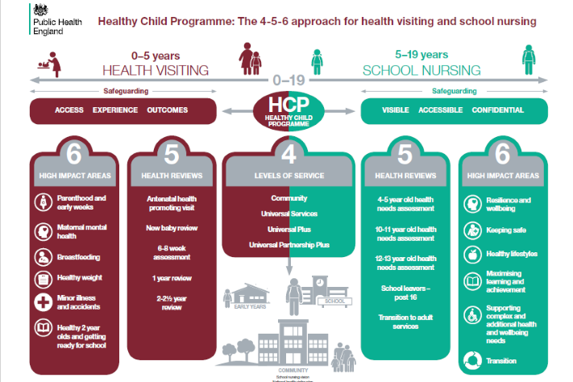
5-19 UNIVERSAL CORE OFFER

Slide 8
Suffolk School Nursing Service Clinical Pathways

Slide 9
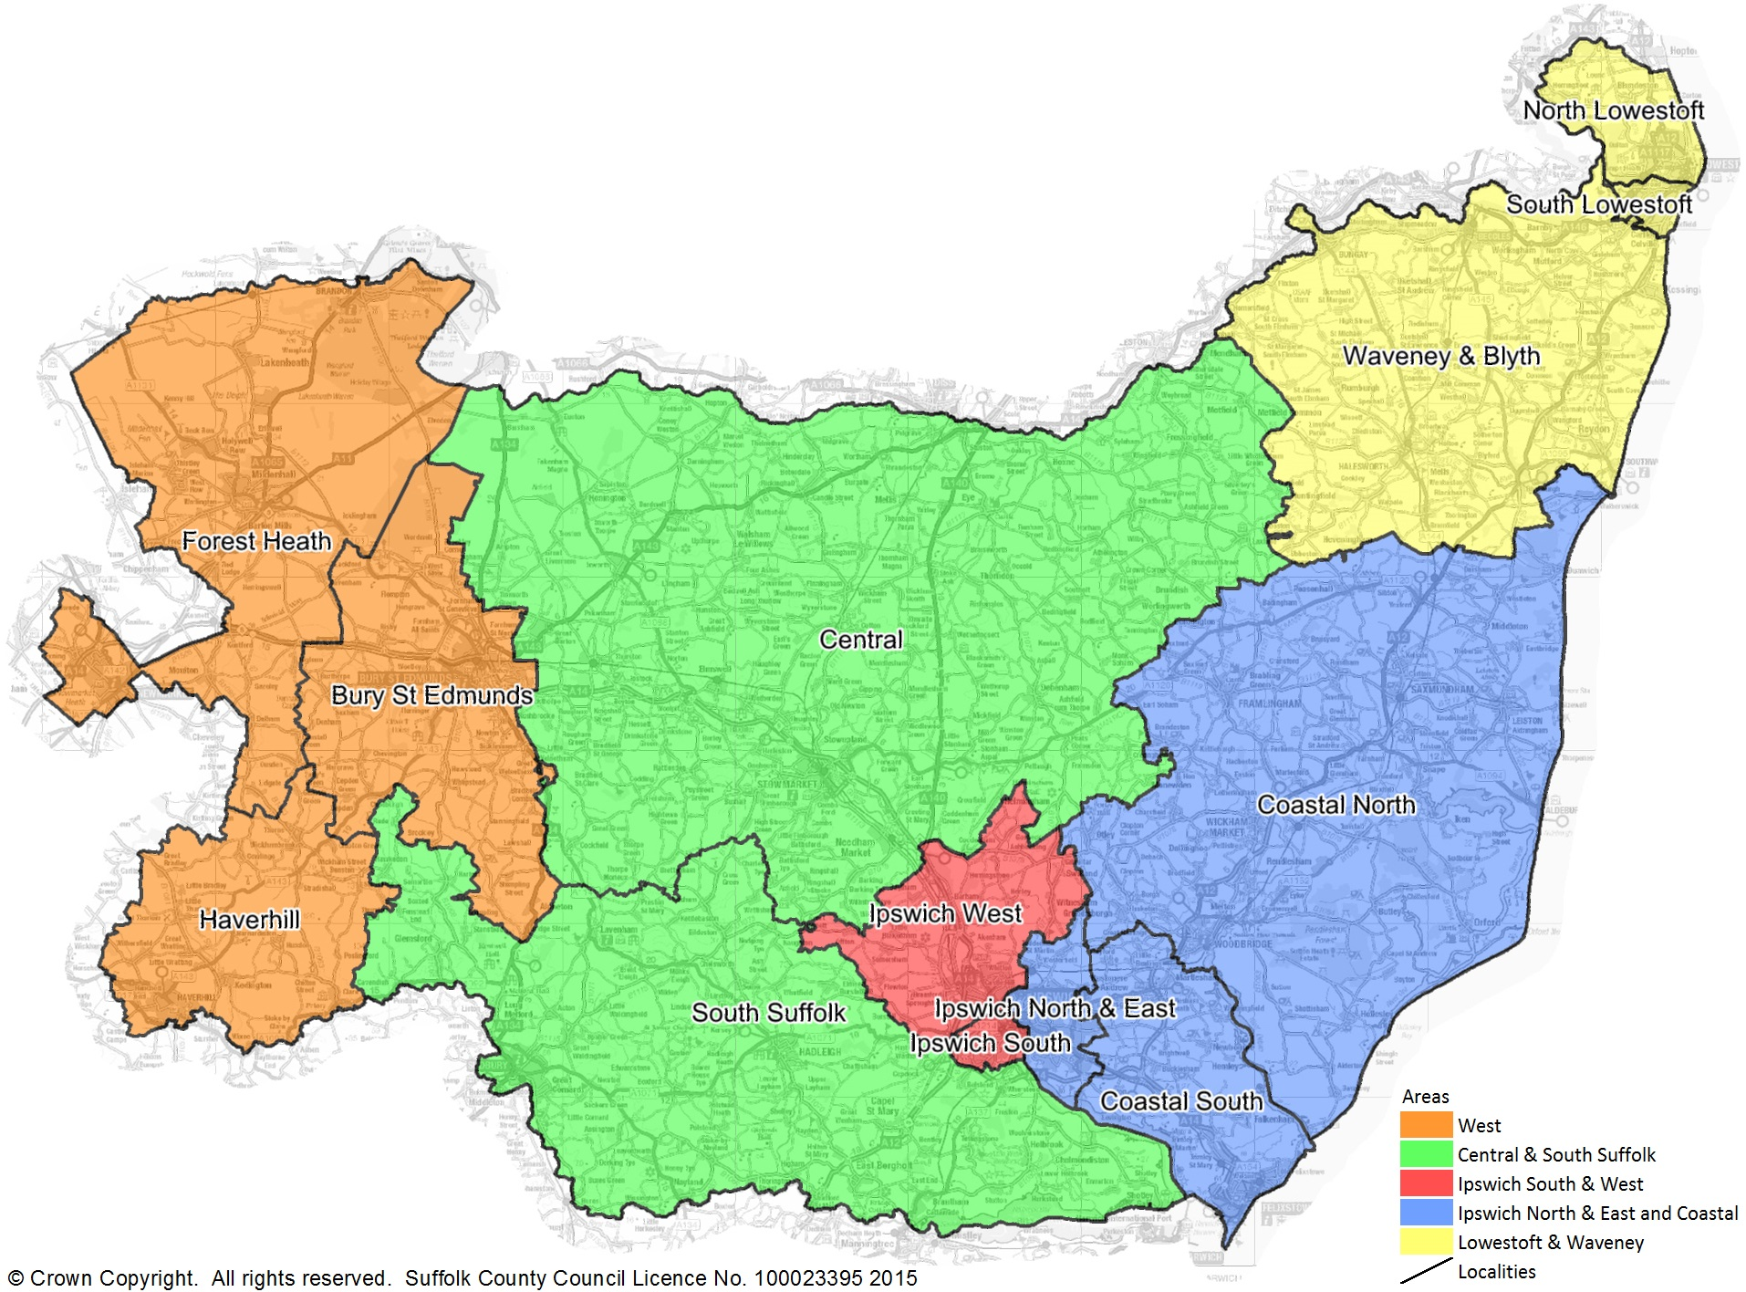

Slide 10
Local map

Slide 11
Local staff

Slide 12
Signs of Safety
SCC utilises The Signs of Safety and Wellbeing framework (SoSWB) within Children and Young People’s (CYP) services.
This supports the work with children, young people, and their families to be focused upon facilitating successful and sustainable change.
We want children to experience a good childhood, so that:
They reach their unique potential
They become socially and economically independent in adulthood
They can nurture their future family successfully.
This practice approach includes key interconnected elements which are used in combination:
Signs of Safety values and behaviours
An overarching comprehensive assessment framework for conversation, thinking and analysis
Ways of working with people and family’s naturally connected networks
Solution building principles and skills
Acknowledging, validating, and responding to people’s everyday lived experiences
Theory and research
To ensure quality and consistency of delivery, SCC requires all clinical staff to be trained in this process and to receive regular updates and training.

Slide 13
Referral received …. What happens next?
The SN Assessment Tool will be used to support SNs and Community Staff Nurses in School Nursing (CSNs) to gain a holistic understanding of each child / young person’s (C/YP) needs, and to make an informed decision regarding the most appropriate clinical pathway and intervention/s required link.
Some C/YP and families will present with a variety of complex needs in challenging circumstances. While more than one pathway may be relevant in these cases, the C/YP will be allocated to the most appropriate pathway and level of intervention. As the needs of CYP and their families are likely to change over time, it is expected that their care pathway will change responsively to meet their needs depending on their priority.
The School Nursing Alternative Provision (SNAP) team support CYP that attend special schools. The health needs of these CYP are often more complex and they frequently require support to be offered at a UP or UPP level. The SNAP team have their own assessment tool, care planning and discharge documentation which complement those used by the Community Learning Disability Nursing Team link. This enables CYP to have a ‘step-up’ referral to the Community Learning Disability Nursing Team if required link.
Timeline:

Slide 14
Screening
Screening is a way of finding out if people are at higher risk of a health problem, so that early treatment can be offered, or information given to help them make informed decisions.
Holistic screening approach for Reception Children;
Hearing
Vision
Height & Weight

Slide 15
Screening
Child Health Screening Practitioners (CHSPs) are responsible for organising, co-ordinating and overseeing the school screening in their area.
This includes:
Liaison with the school in advance of the screening to ensure appropriate room allocation.
Ensuring schools are aware of the details of all pupils required to have screening and the day it will be carried out.
Teachers should be invited to put forward any concerns regarding any child's development prior to screening.
Parents will have received a health questionnaire.

Slide 16
Chat Health – picture is link to video
ChatHealth is an easy way for young people (aged 11-19 years) to confidentially ask for help about a range of issues, or make an appointment with a school nurse, by sending a text message.
This service is provided by Suffolk County Council's School Nursing Service covering all of Suffolk including Lowestoft and Waveney and aims to provide timely and convenient access to confidential health advice for students, including issues about:
Sexual health
Emotional health and wellbeing
Bullying
Healthy eating
Smoking, drugs and alcohol
Self harm
General health concerns

Slide 17
Contacting the School Nursing Service
Call our Health Business Centre on 0345 607 8866 or email childrenshealth@suffolk.gov.uk
Referrals
If you would like to make a referral for some additional support from a School Nurse, please complete our referral form found on SCC Website under School Nursing.
Please note, a parent, carer or young person, you can self refer either via the referral form, calling us on 0345 607 8866 or via ChatHealth.

