Slide 1
Managing Chronic Pain
In Schools and Colleges
Dr Konrad Jacobs
Consultant Clinical Psychologist
Oxford Centre For Children and Young People in Pain
@oxfordpain
@konradjacobs

Slide 2
Website / Video

Slide 3
What are the biggest issues you face at school in relation to pain / fatigue / physical symptoms without a clear pathology?
Please write these in the chat

Slide 4
Aims
What is Acute Pain?
What is Chronic or Persistent Pain?
Managing chronic pain in school and colleges

Slide 5
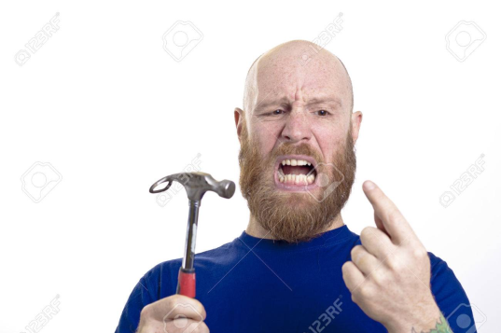
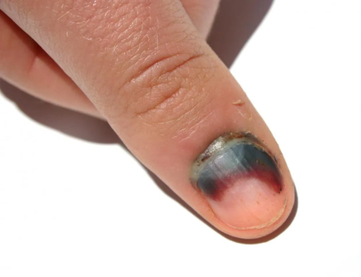
What is Acute Pain?
Usually comes on suddenly and is caused by something specific.
It is sharp in quality.
Usually does not last long
It goes away when there is no longer an underlying cause for the pain

Slide 6
Pain is our
body’s protection system

Slide 7
Why do we need to feel pain?
Alert To warn us something bad has
happened
Warning Something bad might happen
Healing To stop us doing more damage
Learning To remind us not to do it again

Slide 8
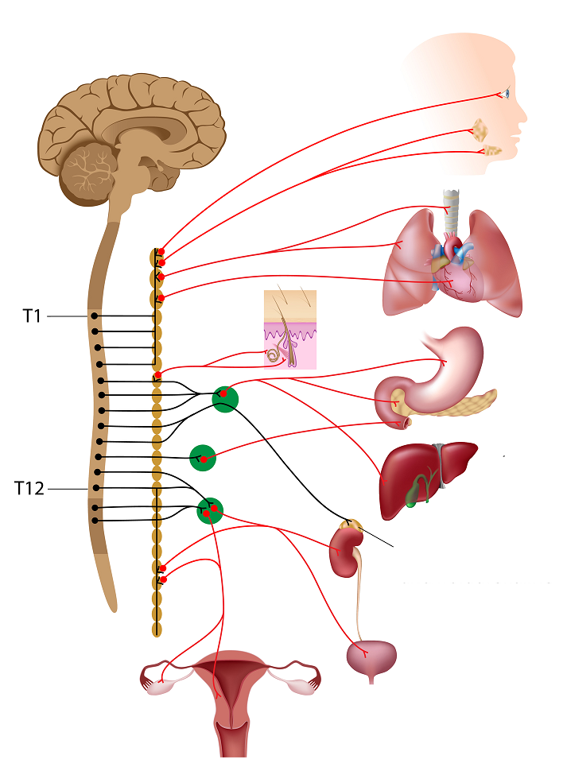
Effects of Sympathetic Nervous System (SNS).
This is your FIGHT or FLIGHT or FREEZE response to a situation
  Senses more Alert – Eyes, Skin
  Increased tension in Muscles
  Increased rate of breathing
  Feeling of Nausea
  Increased Heart Rate
Increased production of Adrenaline and Cortisol
All this can lead to an increase feeling of Agitation

Slide 9
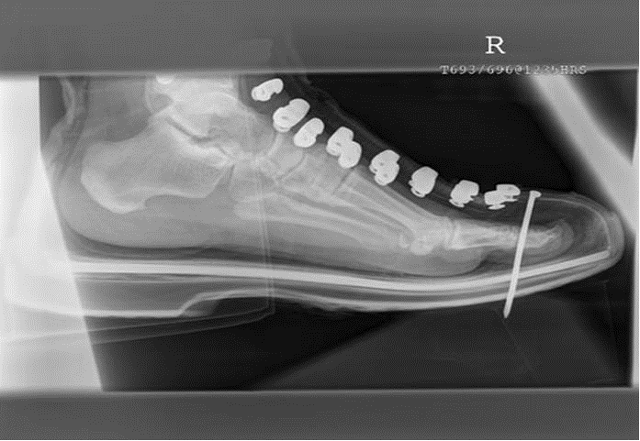
The role of expectations in pain experience

Slide 10
Anticipation of Pain….
Your brain starts to think about what might go wrong even before it has happened!
Pain Memories….
Our CNS will remember an event that caused pain so we do not do it again

Slide 11
Summary - Acute Pain
Has a Trigger
Stops once your injury/illness has healed
Medication works
Draws your attention
It’s Warning you to protect
It’s the body’s way of saying it feels threatened
It’s Useful

Slide 12
Biomechanical Pain
Muscle weakness / tightness / overexertion
Often the result of lack of activity or changes in posture

Slide 13
Chronic Pain

Slide 14
Chronic Pain
Complex Regional Pain Syndrome – CRPS
Juvenile Fibromyalgia Syndrome – FMS (LIPS; DIPS)
Headache
Back pain
Recurrent Abdominal Pain - RAP
Hypermobility syndrome
Ehlers Danlos Syndrome
Biomechanical
Other

Slide 15
What do we know about chronic pain??

Slide 16
IT IS REAL!!

Slide 17
CHRONIC PAIN IS COMMON!!
Perquin et al.
%
Age in Years
Notes:
17
More than 5000 children, self-report data; 82 % response rate
Chronic pain: occurring weekly for more than 3 months with VAS scores above 5
Most prevalent: limb pain, headache, abdominal pain

Slide 18
Chronic Pain can Occur in
ANY Part of the Body
Notes:
18

Slide 19
Chronic Pain……
Injury Healed or spontaneous pain
Healing has finished….
3. Warning Far too soon
Learning …….... the wrong message!

Slide 20
Perception
Sometimes the Brain can interpret information in a way which it thinks is helpful, but this is not always the case.
For Example, these optical illusions….

Slide 21

Can you see the triangles? Are they really there??
Sometimes our brain tries to help us by creating a perception of something it thinks should or could be there, but it misinterprets……

Slide 22
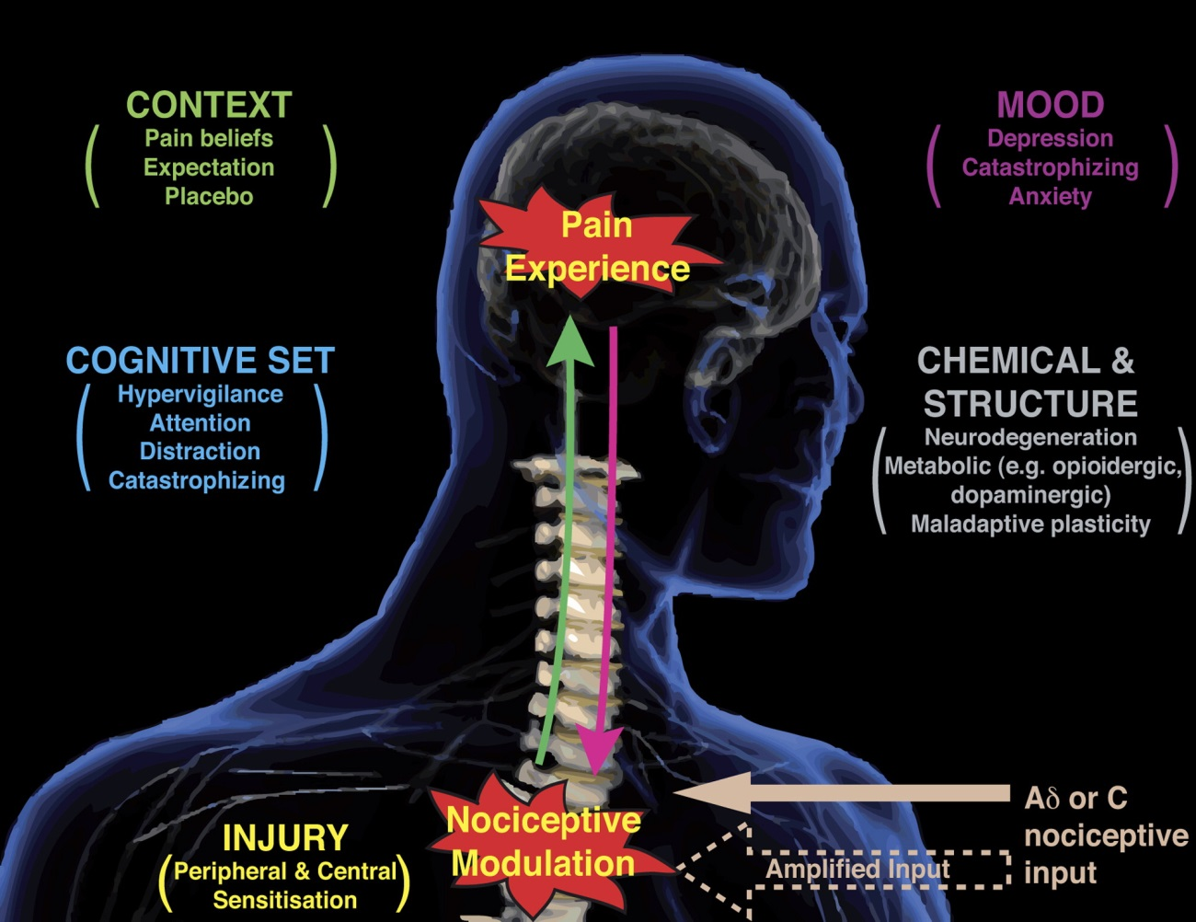
Pain is complex!
Sensory input goes into the brain…..and becomes a pain experience…
…because the brain interprets there is a threat to the system
Both peripheral sensors as well as the brain become more sensitive to normal information (‘sensitisation’)

Slide 23

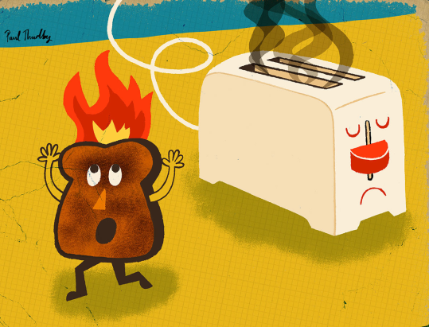
Chronic Pain Metaphors
In the case of chronic pain, the Pain system has become Like a Fire alarm that is too sensitive
Notes:
23

Slide 24

Chronic Pain Metaphors
How is it possible I am in so much pain when they did not find anything on scans / blood tests (or found things but it does not explain the extent of my pain)??
In the case of chronic pain, there is nothing (or not much) wrong with the hardware (the body), but rather, the software (pain processing) is faulty
These are some really nice metaphors of what is happening in chronic pain. You can use these to explain chronic pain to others.
Notes:
24

Slide 25
Fight / Flight / Freeze response to chronic pain
Fight:
You feel overwhelmed and get angry. E.g. you lash out at family, get angry with yourself or your pain
Flight:
      You feel overwhelmed and want to leave the situation you are in, e.g. leaving school, an outing with friends,
Freeze:
You feel overwhelmed and do not want to leave the situation you are in, e.g. you want to stay at home and not go to school, out with friends, etcetera

Slide 26
Treatment
Medical Treatments
Often fail
Rehabilitation
Gradual return to normal activities, including school
Address biomechanical issues
Return to normal family life
Address psychological functioning
Address systemic issues
Address other issues: sensory problems, ASD, bullying, etcetera

Slide 27
Chronic Pain Management
Need to move from thinking about a cure for pain
To thinking about managing the pain
To try to be as active as possible despite pain
To accept pain as a given at this stage of life
To reduce negative thinking / emotions
To normalise family life
Notes:
27

Slide 28

The spiral can go down, and the spiral can go up!
Pain Sleep
Doing things Mood / stress

Slide 29
Summary: Chronic Pain
Long Term: > 3 months
Often not understood by others
Not Visible
Does not respond well to medications
It’s not warning you of a current injury/illness
…but your brain thinks it’s under threat
Not Useful
It is real

Slide 30
Psychological or Physical
Symptoms are not only ‘psychological or ‘physical’
Pain leads to negative feelings
Negative feelings can lead to more pain and disability (via fight-flight-freeze response and threat perception) but pain usually does not go away completely when negative feelings do

Slide 31
Fluctuations in performance
Fluctuations are NORMAL
And are NOT signs of malingering
But instead are related to fluctuations in THREAT perception

Slide 32
Parents
The LARGE MAJORITY of parents do their best in difficult circumstances
Factitious or induced illness by proxy?
When to involve safeguarding / MASH?

Slide 33
Negative things Children & parents say about school
They don’t believe I am in pain / tired / have physical symptoms
They don’t understand that some days I can do more than other days
They are not being helpful / accommodating
Not all the teachers know about my pain
Other children make comments
They treat me as if I am doing this to my child

Slide 34
Engagement
Being empathetic and explicit in conveying belief in the reality of the experience of physical symptoms
Shift focus from ‘cause’ to ‘symptom management’
Avoid physical versus psychological discussions
Use physical illness analogies to illustrate approach (“what we do with children with other health conditions is….”)
Challenge therapeutic nihilism/room for optimism

Slide 35
Management - 1
ENGAGEMENT!
Take seriously even in cases of clear ‘manipulation’
Reduction in anxiety levels
Normalising symptoms (“We have lots of other children with pain in the school”)
Close contact with teams / school / GP to avoid ‘splitting’ in cases when child / parent is highly distressed; don’t be afraid to contact clinicians and ask questions (with permission of the family)

Slide 36
Management - 2
Phased return to school – same number of hours each day
Who does the child / parent get on with in the school? It does not always have to be the HOY, it is about engagement with the family
Clear, timely communication – these parents are often very worried
Weekly one-to-one check-in with favourite teacher to discuss the week and any difficulties that have arisen

Slide 37
Management - 3
Pain-flare planning: what does the young person do / where does s/he go in case of pain flares at school?
Address practical issues: moving around the school, going to the toilet, carrying a heavy bag with books
Share the ‘Pain and school’ website (see ‘resources’)
Try to avoid confrontations
Put it all together in a mutually agreed written plan which is reviewed regularly

Slide 38
Useful Resources
Website Recommendations:
Pain bytes : http://www.aci.health.nsw.gov.au/chronic-pain/painbytes/
Pain and School: https://www.aci.health.nsw.gov.au/chronic-pain/painbytes/pain-and-school
Retrain pain: http://www.retrainpain.org/
Understanding Pain in 5 minutes: https://www.youtube.com/watch?v=C_3phB93rvI
Book Recommendations:
Tonya Palermo - Managing your Child’s Chronic Pain
Frances Cole - Overcoming Chronic Pain (for older adolescents / adults)
Moseley & Butler – The Explain Pain Handbook – Protectometer
Jennifer Shannon – The Anxiety Survival Guide for Teens
Cathy Creswell & Lucy Willetts – Over Coming your Child’s Fears & Worries

Slide 39
Konrad.jacobs@ouh.nhs.uk
Joint conference MNIS and OXCYPP
26.02.2021
02.02.2021
09.02.2021
All your EHCP questions will be answered

